Slide 1
Ad verecundiam and credibility
Mirko Farina
Assistant Professor
m.farina@innopolis.ru
* I do not claim authorship for all texts and pictures in the presentation.

Slide 2
In the last two lectures we focused on logical fallacies.
We distinguished four major categories of fallacies.
These are:
Fallacies of Diversion (Straw Man, Red Herring, Irrelevant Conclusion)
Fallacies of Structure/Distribution (Affirming the Consequent, Denying the Antecent, Undistributed Middle, Illicit Major/Minor, Negativity)
Fallacies of Language (Amphiboly, Equivocation)
So called ‘ad’ arguments (Ad Hominem, Ad Populum, Ad Baculum, Ad Misericordian, Ad Ignorantiam).

Slide 3
One further ‘ad’ argument that deserves fuller study is the so-called Ad verecundiam, or the Appeal to Authority or Expertise
We will devote the first part of this lecture to analyzing this fallacy and its ramifications.
Having done so, we will look at the issue of credibility (part 2), which this fallacy nicely introduces

Slide 4

Ad verecundiam (appeal to Authority) – part 1
The Appeal to Authority is a strategy in argument that few can avoid making.
When my doctor tells me that I must make some serious lifestyle changes or else expect undesirable onsequences to follow, then my deliberations in deciding whether to make such adjustments involve a direct appeal to her status as an authority.

Slide 5

She has knowledge that I do not possess, coupled with many years of experience reviewing the symptoms of people comparable to me.
Thus, she seems to be in a better position to judge my health than me.

Slide 6
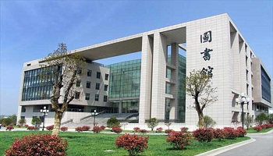
In principle, I could acquire this knowledge and experience directly, but it is simply not practical for me to enter medical school and subsequently practice as a family physician.
In the absence of the direct evidence that it is not practical for me to acquire, I rely on the testimony of an expert

Slide 7
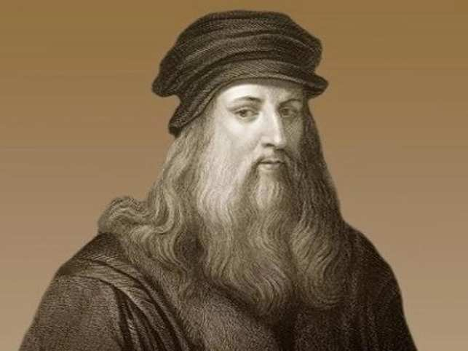
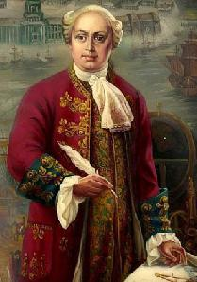
Similar situations govern a wide range of my interactions with people or sources that are judged authorities of some description.
In the extremely complex world in which we live, no one can be expected to be knowledgeable about everything that affects him (long gone is the time of polymaths such as Leonardo or Lomonosov) and so we must necessarily rely on and trust of other people

Slide 8
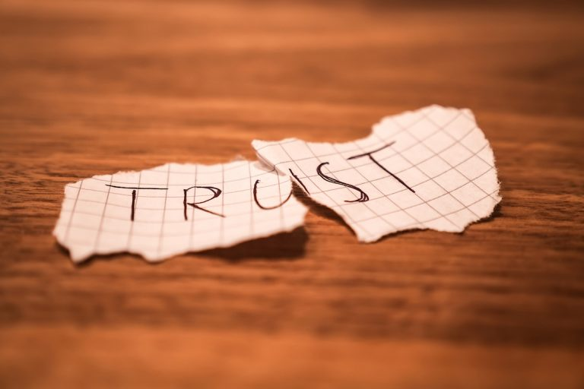
Trusting someone is thus a very serious issue.
Deciding whom to trust can have huge implications not only for your professional life but also for your daily life.

Slide 9

Consider, for example, the way teams of scientists
conduct their work.
Invariably, they build on the work of previous
teams in their own and related fields. They accept the results of others’ experiments and sometimes the conclusions inferred from those results.
It would be impractical and often impossible for the
teams to replicate all the experiments on which they rely. Hence, they accept them on the authority or expertise of those who conducted them, assuming they have been conducted according to professional standards and procedures

Slide 10

When consulting a physician or mechanic, I do not think that my subsequent deliberations are fallacious. I just trust him/her because he/she has knowledge that I don’t have.
So, we need to explore the fallacy in more details and consider the various ways in which it may arise…

Slide 11
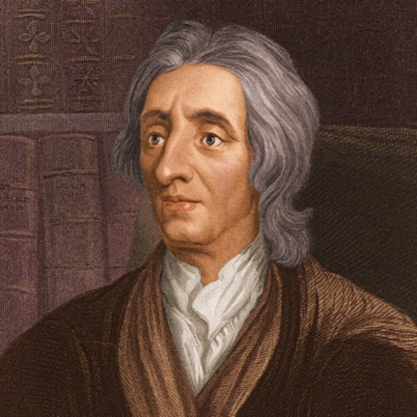
In the previous lecture we saw that Locke first systematized, in a coherent and organic way, all ad arguments, and we still use his classification.
In Locke’s original treatment of the argumentum ad verecundiam, he points out that ‘people may draw on someone of eminence’, using that person’s word as backing for a claim.

Slide 12

This gives weight or power to the argument because the audience, feeling an appropriate awe in the face of such an eminent authority, would be ashamed to challenge that person’s word and hence is led to accept the argument.
Locke suggests that there is something problematic about this persuasive move, ‘There is something clearly coercive going on in this’; and he is right to think so
…

Slide 13
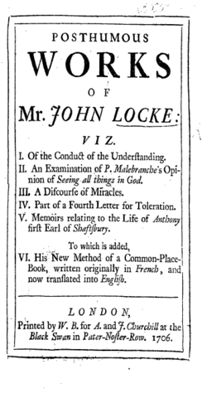
Locke is vague, though, in regard to the nature of the authority involved.
His description involves more than just knowledge; it includes, for instance, prestige and fame, which could derive from many sources.
We can imagine, for example, how social standing would have carried more weight in Locke’s time (the late 1600s)
than it might today

Slide 14
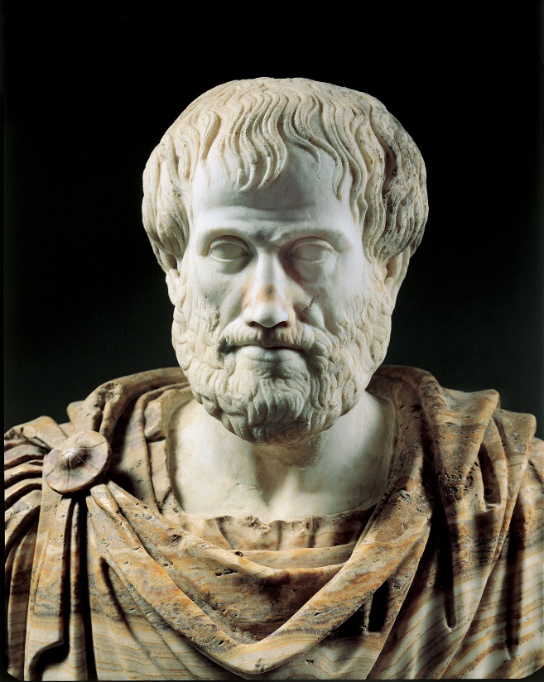
What Locke may have in mind here is the way people would defer to others who were thought to have greater status.
A clear example is the way scholars in the mediaeval world deferred to the authority of Aristotle.
To illustrate this: we can also think about the kind of authority that would have been exercised by a king or the pope; or in general a person who had enormous political power.
His saying something would be a reason for acting on the assumption that it was the case, even if it was not a reason for believing it

Slide 15
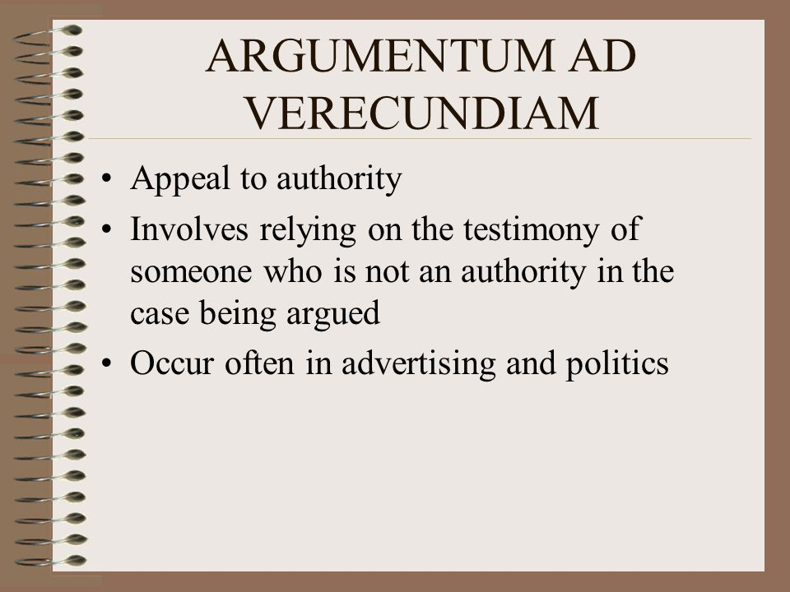
This is clearly one type of authority that we must consider when discussing the ad verecundiam.
We might call this the ‘argument of authority’, which stems from the particular position a person holds.

Slide 16
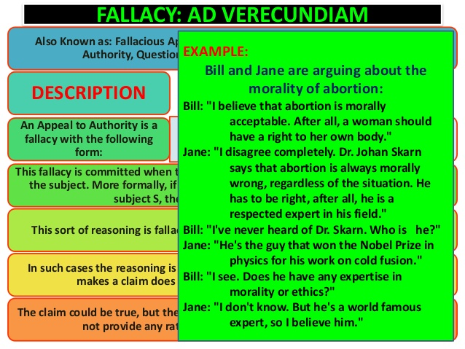
Modern treatments, however, tend to stress the cognitive element in authority arguments and restrict the ad verecundiam to arguments that draw on authorities for specific kinds of knowledge that it is not possible to provide in any other way, such as the appeal to the doctor discussed earlier.

Slide 17
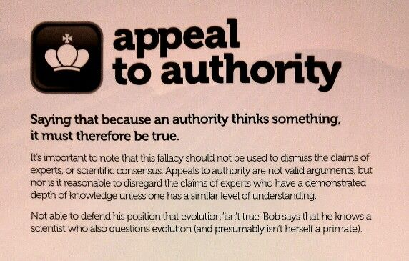
Here, the person has eminence by virtue of possessing a type of expertise that is not generally available.
For this reason, Modern Appeals to Authorities are often called Appeals to Experts.

Slide 18
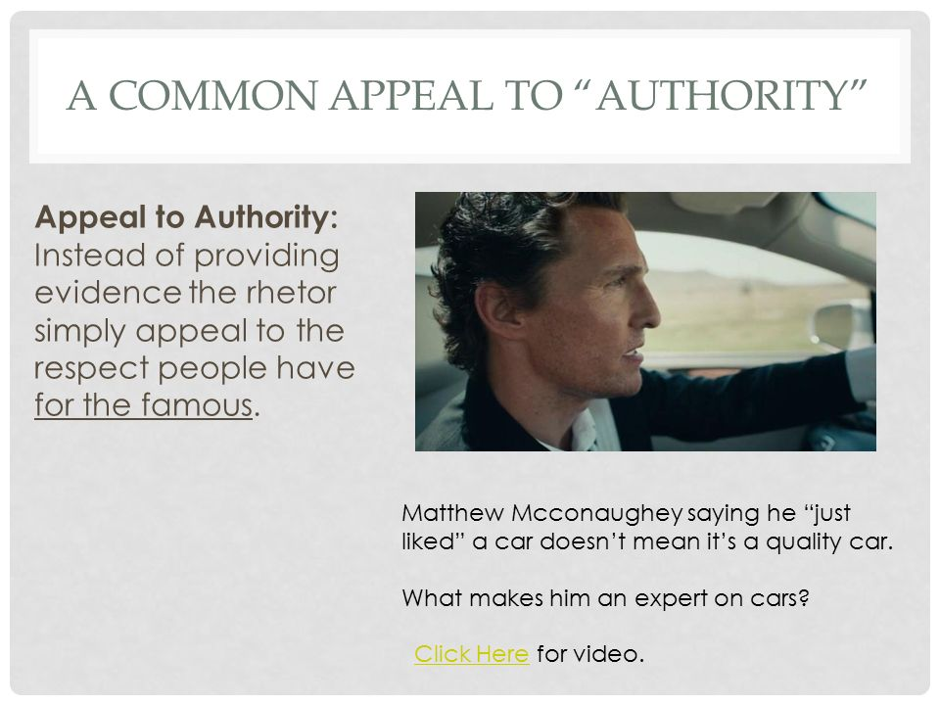
A person or source is in a position of expertise if her position in a field of knowledge is such that her pronouncements
are likely to have a higher rate of success or accuracy than those of a non-expert
Examples:
Doctor
Chemist
Physicist
Mechanic
…..

Slide 19

So an expert is characterized, at minimum (we will return to this point later on) by having expertise (knowledge) and experience.
The combination of these factors has a particular influence to our minds…

Slide 20
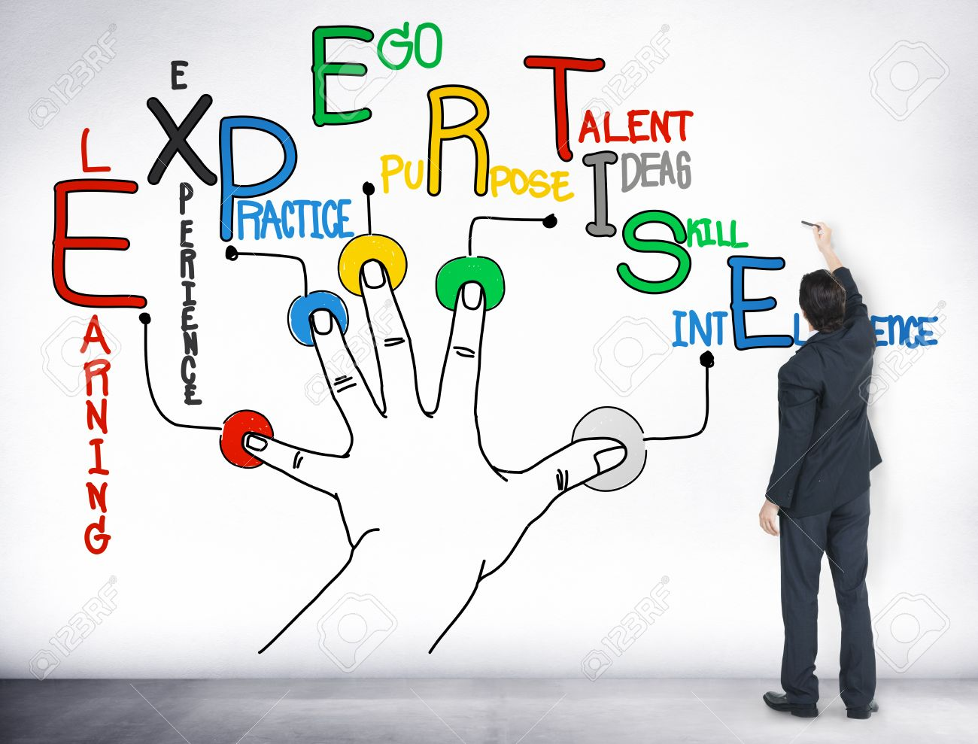
So, when arguers appeal to experts, we seem to accept their claims without reserves.
Here we have the following scenario:
p1. Someone (or some source) asserts a statement S.
---
c. Therefore, S is true.

Slide 21
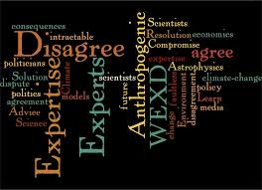
Attempts have been made to construe both formal and non-formal versions of this fallacy. Hamblin, whose work we already reviewed when we talked about fallacies of distribution, has this nice example”
p1. Everything X says is true.
p2. X says that P.
----
c. Therefore P.

Slide 22

The crucial premise here is the first one, which renders the argument form valid.
But unless that premise is an appeal to a divine being, it claims too much, and certainly more than could be verified

Slide 23

In fact, implicit in that premise are many of the problems that are associated with the Appeal to Authority, that so often result in its fallaciousness. To illustrate these problems, consider the following example:

Slide 24
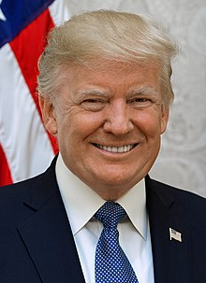
EXAMPLE 1
p1. Everything the president says is true.
p2. The president says that Iraq has weapons of mass destruction.
--------
c. Therefore, Iraq has weapons of mass destruction.

Slide 25
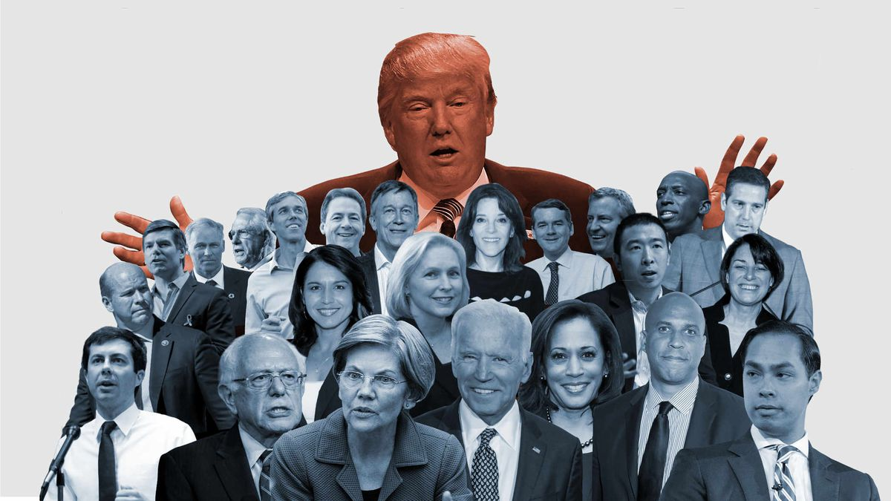
This is obviously a controversial example.
But for our purposes here the statement deserving most attention is the one offered as the first premise

Slide 26
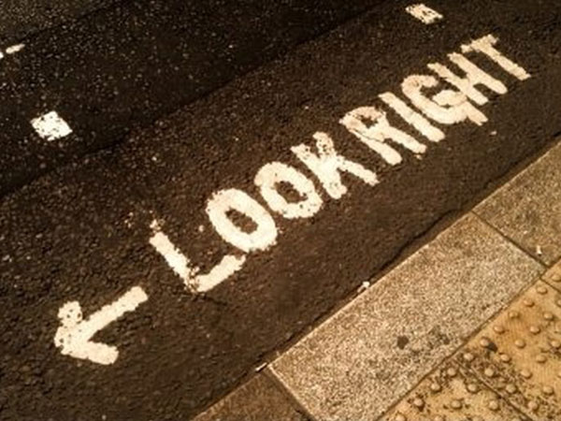
Given what we know about human beings it seems unlikely that someone could always be correct in his or her pronouncements.
But we need to consider what exactly is wrong here beyond this questionable plausibility.
Would someone be misled by such a claim?

Slide 27
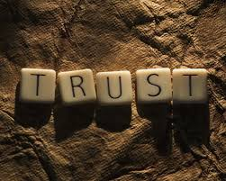
Locke’s original treatment of the ad verecundiam suggests that someone might, because he may have such a high regard for the office of the president, so as to be inclined to give the holder of that office the benefit of the doubt.
[By the way, the same example could be constructed with a famous academic whose findings have been groundbreaking in his field]

Slide 28
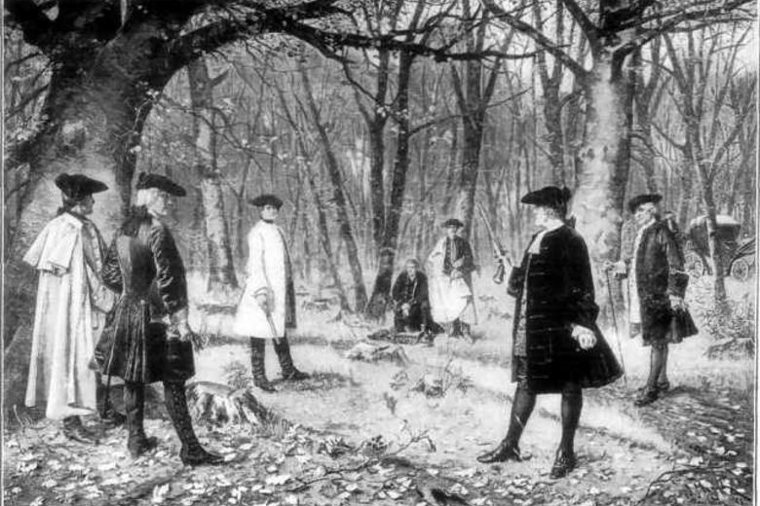
That is, he would be ashamed to challenge the word of the president because of who he is, believing perhaps that all claims he would make were the result of intelligence gathering that would justify them.
But there is clearly a problem with this argument because the first premise appears as an attempt to immunize the argument from criticism

Slide 29
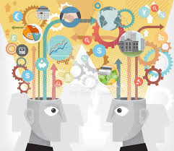
Presented in a dialogue, for example, it would have the effect of preventing any critical challenge in advance and so impeding the progress of the dialogue.

Slide 30
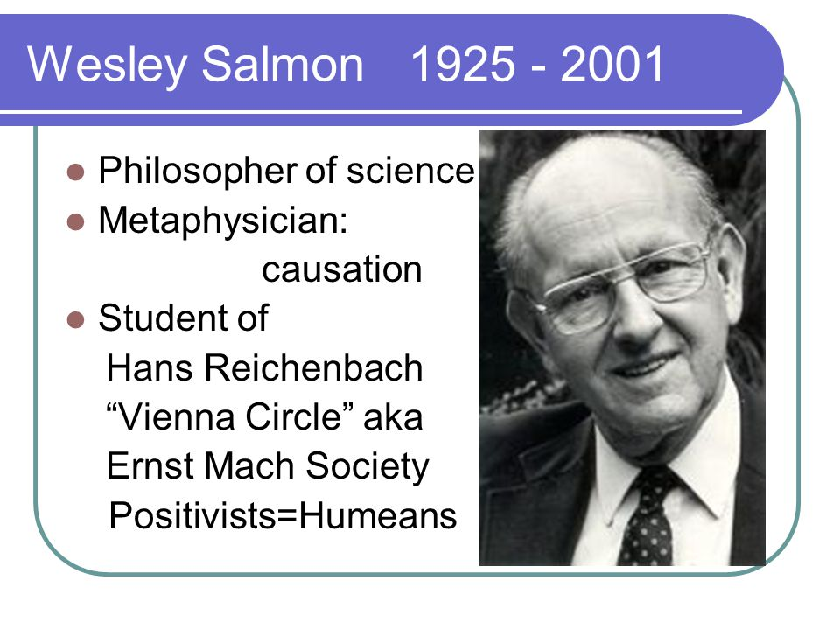
Those who judge the Appeal to Authority as always fallacious would focus on just this sort of example, which are super clear
But there are other ways of phrasing the general appeal to authority that show it to be more complex than this.
Wesley Salmon, who was a logician offered an inductively correct version of the strategy as the fallacy:

Slide 31

p1. The vast majority of statements made by E concerning subject S are true.
p2. A is a statement made by E concerning subject S.
----
c. Therefore, A is true.

Slide 32
Being an inductive form of reasoning, this argument gives probable grounds for the conclusion asserted while it allows that any particular assertion by the expert could be wrong.
In other words: it still leaves a range of contextual questions to be asked relating to the expert in question, the subject area involved, and what has been stated on the occasion in question. Consider the following example that fits this pattern

Slide 33
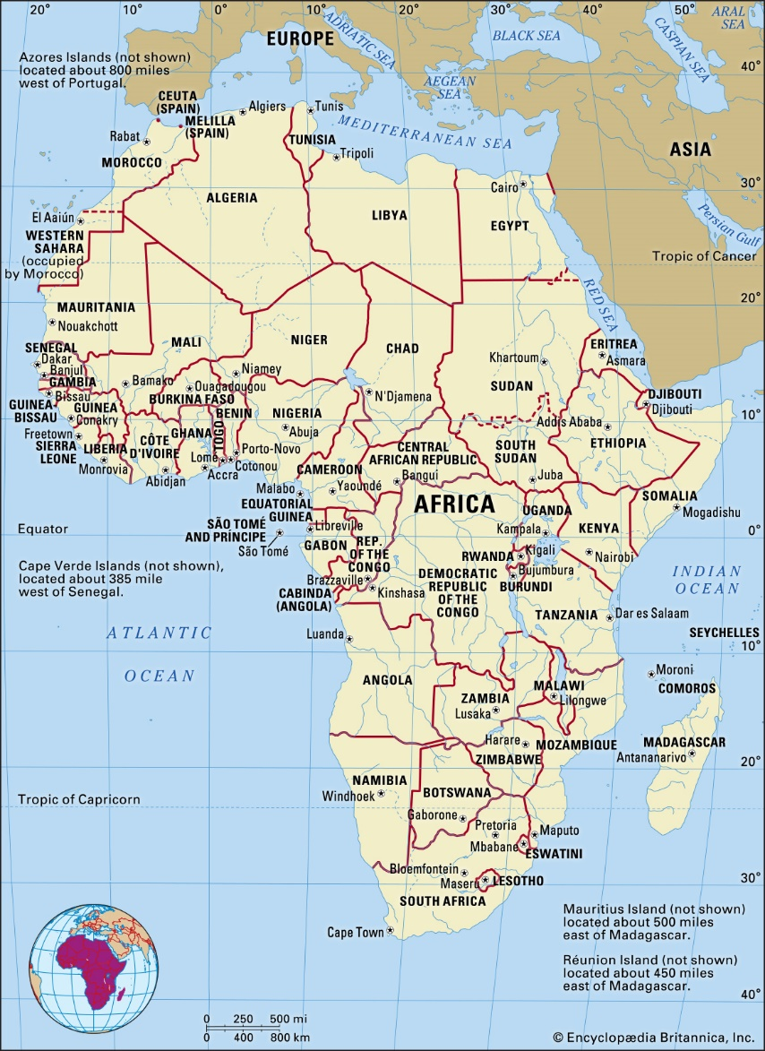
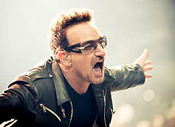
EXAMPLE 2
p1. The vast majority of statements made by the singer Bono concerning AIDS in Africa are true.
p2. Bono said AIDS in Africa is the worst pandemic in 600 years.
------
c. Therefore, AIDS in Africa is the worst pandemic in 600 years.

Slide 34
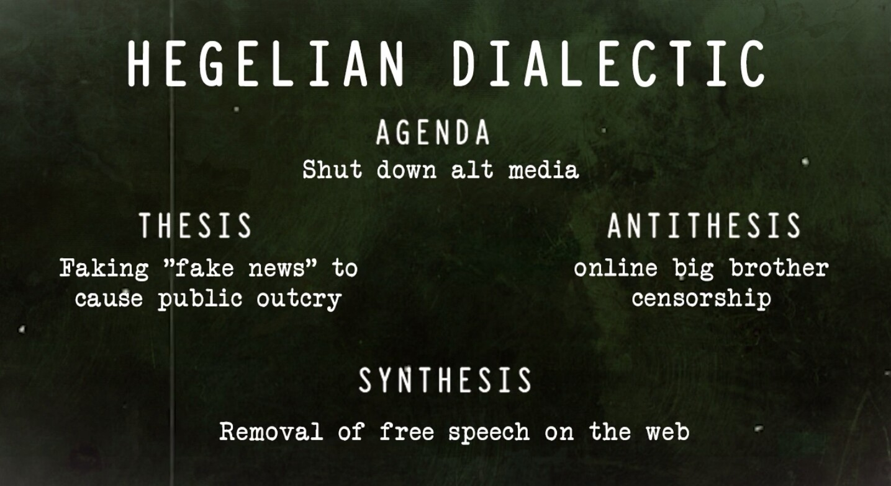
The first premise here avoids the fault of that in the previous example and would allow for a dialectical exchange in which a critic challenged the word of the authority.

Slide 35

What constitutes an expert in this particular subject area and how does a popular singer qualify?
Is AIDS in Africa a clear field of expertise that has a body of knowledge associated with it such that we can speak of experts?
And does Bono have a vested interest here such that it benefits him to associate with a high-profile health issue?

Slide 36

This discussion warrants a more detailed
assessment of the appeal to authority and the formulation of a set of critical questions that can help us deal with the general types of this appeal.

Slide 37
How to avoid it? Ask yourself the following questions
1. Is the proposed person or source a genuine authority?
2. Did the authority make the attributed claim?
3. Are the authority and claim made relevant to the subject
matter?

Slide 38
It is important to understand that appeals to the authority of experts involve greater complexities than these three questions bring to light…
Nevertheless, for your purposes in this course the basic discussion of this fallacy we just had should be sufficient to allow you to deal adequately with arguments involving this fallacy and thus successfully identify instances of this fallacy

Slide 39
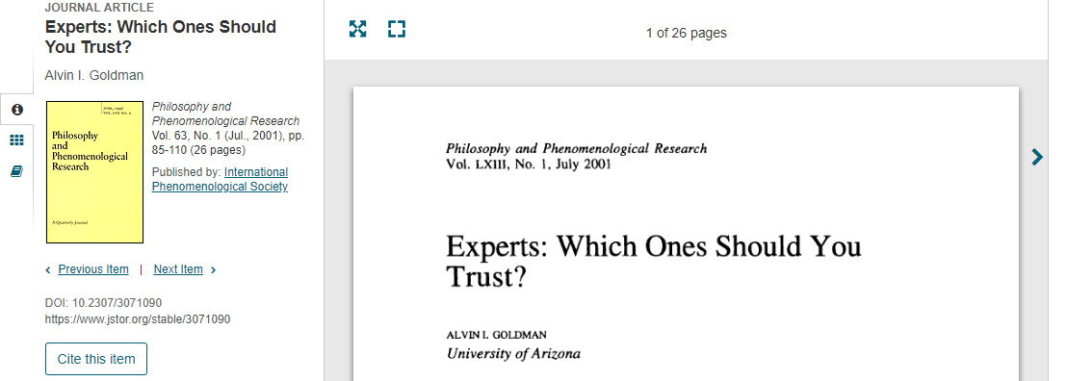
So, if appealing to authority is not a desirable criterion to justify our knowledge of facts. How do we decide whom we trust?
This brings us to the topic of the second part of this lecture, which is Credibility.

Slide 40
Credibility – part 2
EXAMPLE AKIN TO: The Nigerian Advance Fee 4-1-9 Fraud, which is The Internet’s Longest-Running Scam
This is about a friend of mine named Paolo, who many years ago received an e-mail from UniCredit (Italy’s largest bank).
This email notified him that there might be a problem with his credit card account and asked him to visit the bank’s Web site to straighten things out.
A link was provided to the Web site in the email. When Paolo visited the site, he was asked to confirm details of his personal information (to clear security checks)

Slide 41


The Web site looked exactly like
the Unicredit website he had visited before, with the bank’s logo and other authentic-appearing details.
But very shortly after this episode, he discovered that his card had paid for a plasma television, a home theater set, and a couple of expensive car stereos, none of which he had ordered or received.

Slide 42
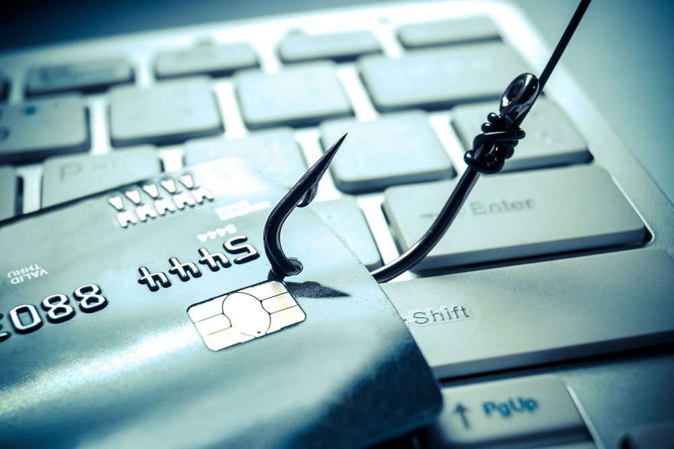
Paolo was a victim of “phishing,” a ploy to identify victims for identity theft and credit card fraud.
Phishing scams are on the rise these days
Some of these phishing scams threaten to suspend or close the individual’s account if no response is made

Slide 43
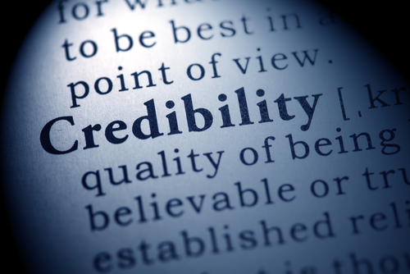
Needless to say, a person should give no credibility to an e-mail that purports to be from a bank or other company and asks for personal identifying
information via e-mail or a Web site

Slide 44
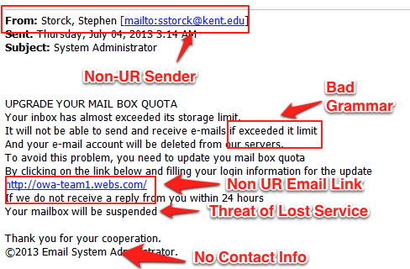
Two obvious reasons for being skeptic!
The first ground is the claim itself. Paolo should have asked himself just how likely it is that Unicredit would notify him of a problem with his account by e-mail and would ask him for his personal, identifying information.
(Hint: No serious bank will approach its customers for such information by e-mail or telephone.)

Slide 45
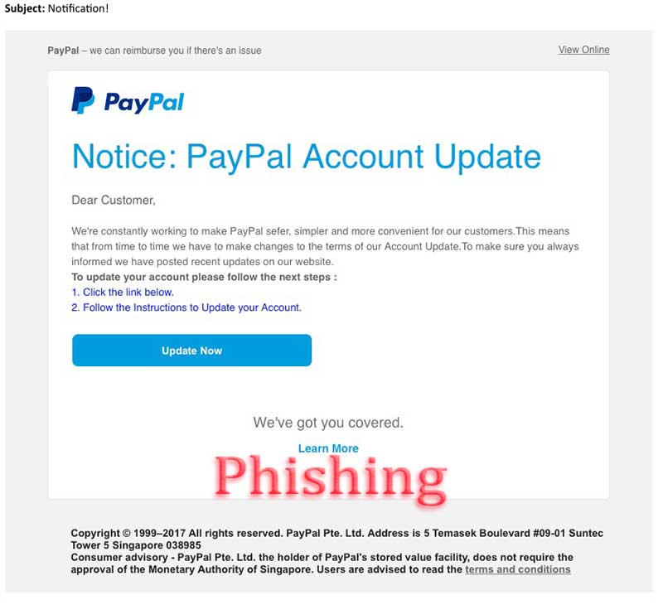
The second ground for suspicion is the source of the claim. In this case, Paolo believed the source was legitimate. But here’s the point, one that critical
thinkers are well aware of these days:
On the Internet, whether by Web site or e-mail, the average person has no idea where the stuff on the computer screen comes from. Computer experts have methods that can sometimes identify the source of an e-mail, but most of us are very easy to mislead

Slide 46
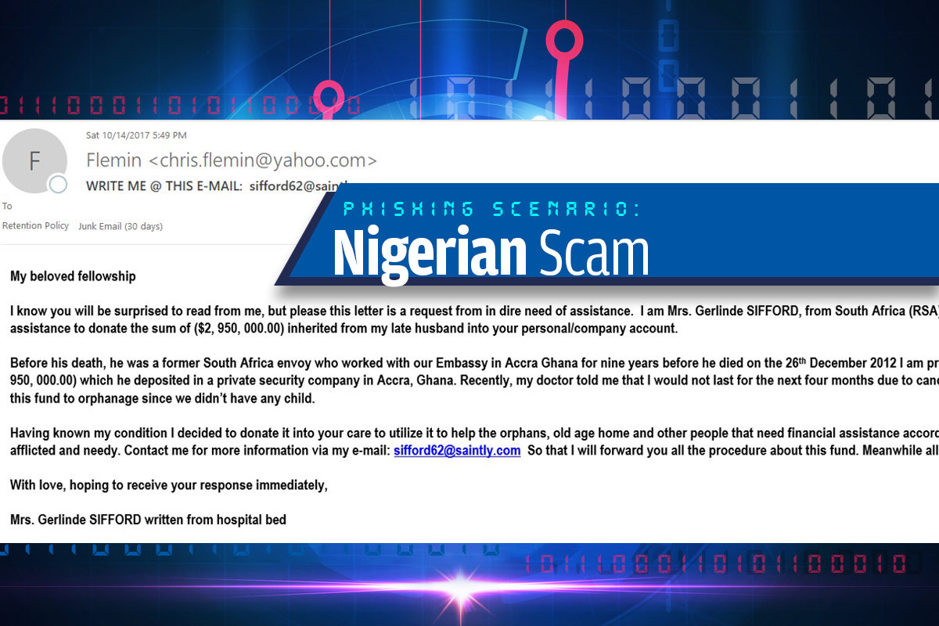
Paolo is no dummy; being fooled by such scams is not a sign of a lack of intelligence.
Just: His concern that his account might be suspended caused him to overlook the ominous possibility that the original request might be a fake.

Slide 47
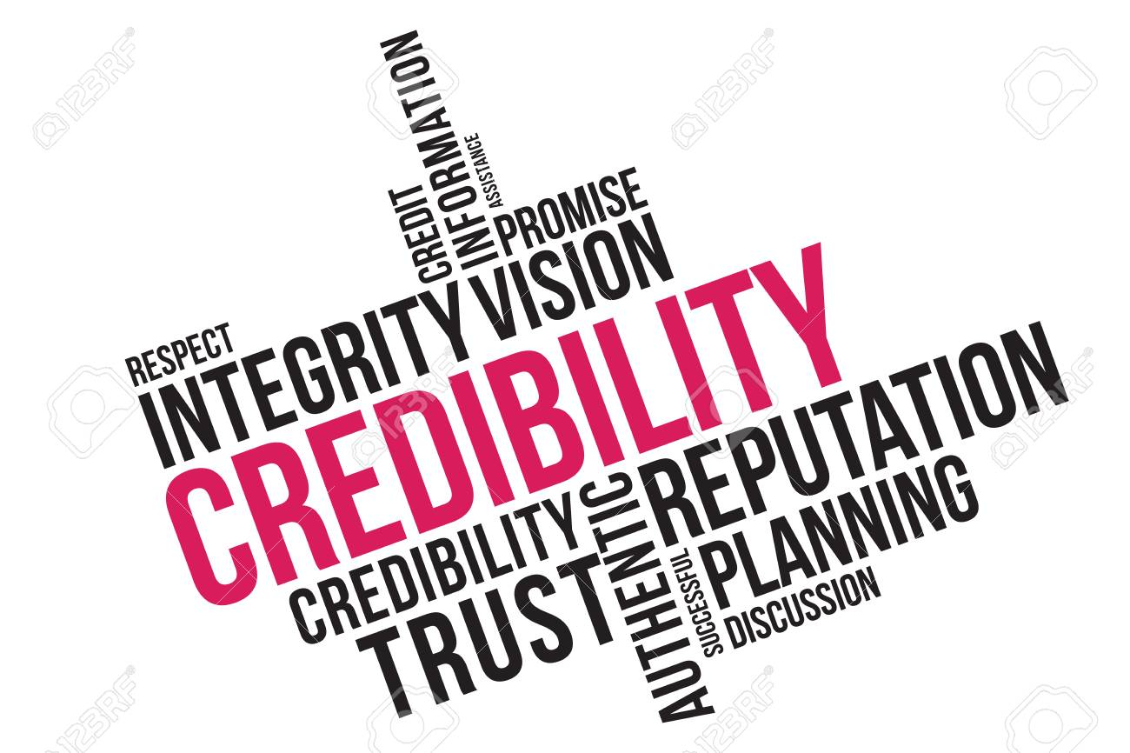
In this phishing story, there are two ways in which we can assess credibility:
1. is that of claims themselves; 2. is the claims’ sources.
Let us analyze these 2 points next

Slide 48
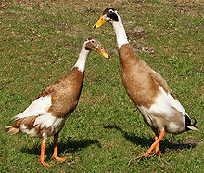
If we’re told that ducks can communicate by quacking in Morse code, we dismiss the claim immediately.
Such claims lack credibility no matter where they
come from

Slide 49
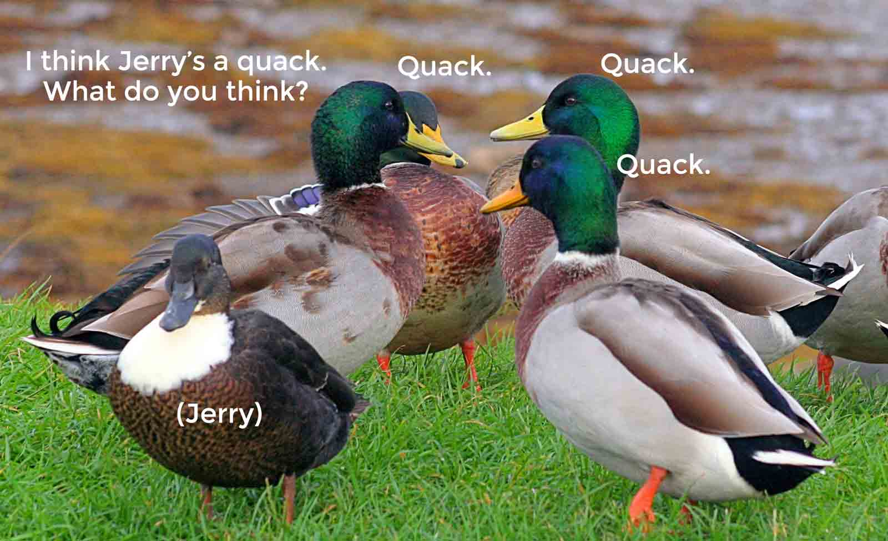
But the claim that ducks mate for life is not at all outrageous—it’s a credible claim.
Whether we should believe it depends on its source; if we read it in a bird book or hear it from a bird expert, we are much more likely to believe it than if we hear it from our nephew, for example

Slide 50
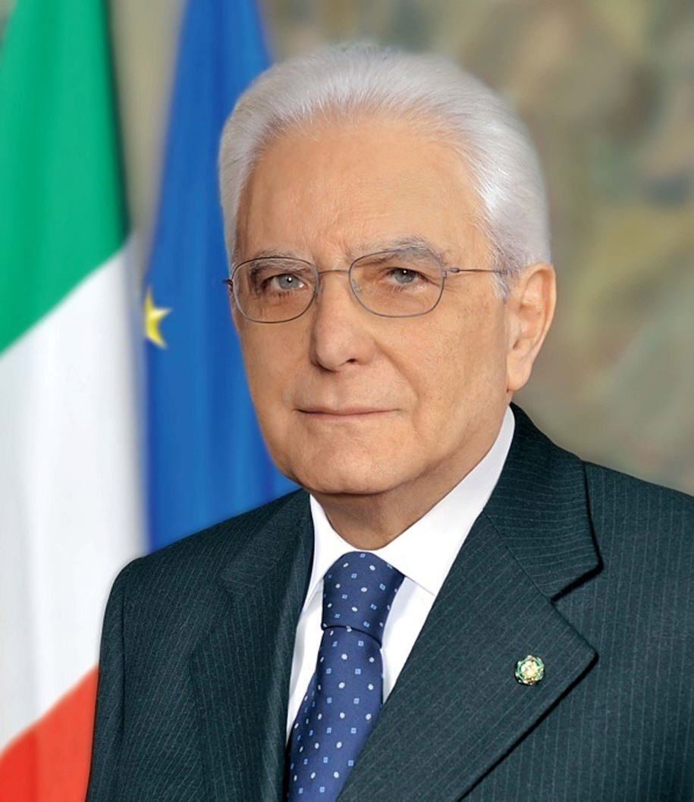
There are degrees of credibility, of course; it’s not an all-or-nothing kind of thing.
The claim that the president of Italy has been secretly abducted and replaced by an actor who is an exact copy strikes us as very unlikely. But however unlikely, it’s still more credible than the claim that the president is in reality an alien from a distant galaxy.

Slide 51
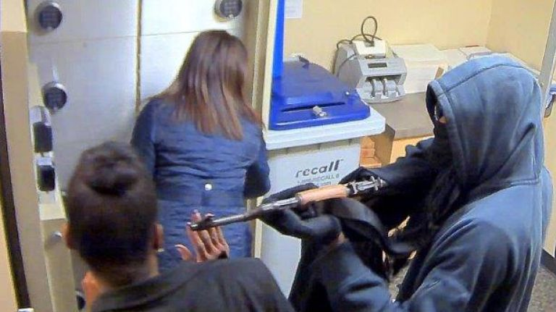
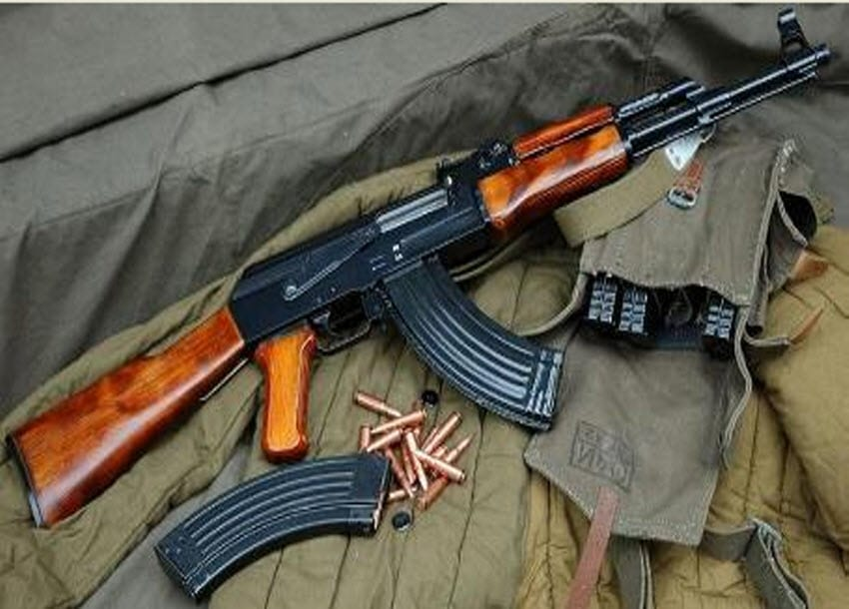
2. Sources vary in their credibility just as do the claims they offer.
If the next-door neighbor you’ve always liked is arrested for bank robbery, his denials will probably seem credible to you.
But he loses credibility if it turns out he owns a AK47 with the serial numbers removed.

Slide 52

Similarly, a knowledgeable friend who tells us about an investment opportunity has a bit more credibility if we learn he has invested his own money in the idea.

Slide 53
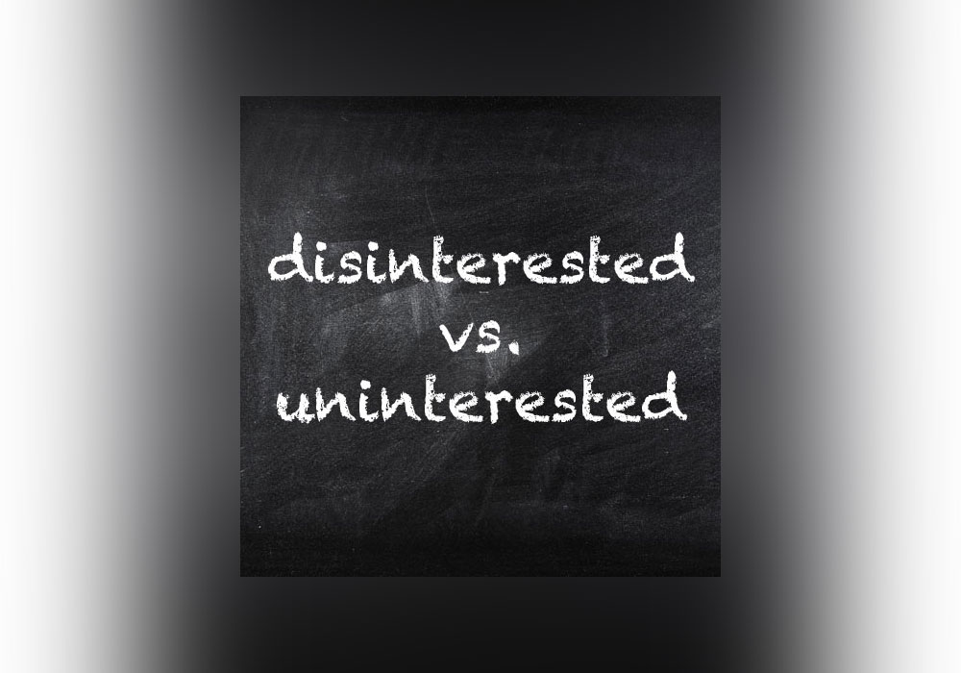
On the other hand, he has less credibility if we learn he will make a substantial commission from our investment in it.
GENERAL RULE:
A person who stands to gain from our belief in a claim is known as an interested party, and interested parties must be viewed with much more suspicion than disinterested parties, who have no stake in our
belief one way or another.

Slide 54

This discussion brings up another important question: On what grounds do we judge a person’s credibility?
Unfortunately, we often base our judgments on irrelevant considerations (e.g. physical characteristics).
Does a person look you in the eye? Does he perspire a lot? Does he have a nervous laugh? Despite being generally worthless in this regard, such characteristics are widely
used in sizing up a person’s credibility.

Slide 55

Simply being taller, louder, and more assertive can enhance a person’s credibility, according to a recent study (Tiedens 2007)

Slide 56
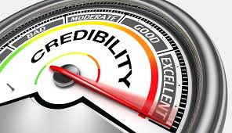
Other irrelevant features we sometimes use to judge a person’s credibility include gender, age, ethnicity, and accent
People also make credibility
judgments on the basis of the clothes a person wears or his attitude.
TWO EXAMPLES:

Slide 57
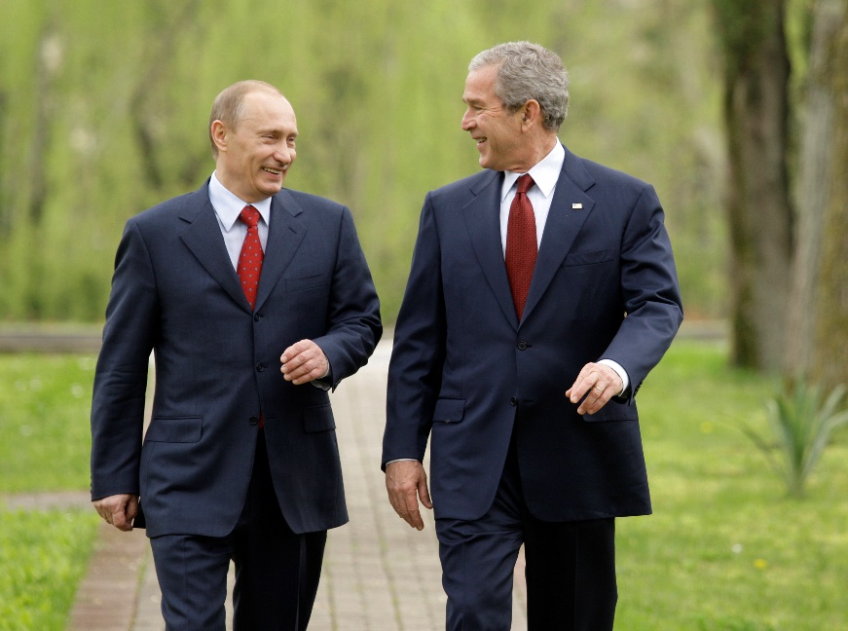
EXAMPLE 1
‘I looked the man in the eye. I found him to be very straightforward and trustworthy. We had a very good dialogue. I was able to sense his soul’.
— GEORGE W. B USH, commenting on his first meeting with Russian president Vladimir Putin
[By the end of 2007 (after a famous speech that Putin delivered in Munich, in which he exposed American Imperialism and said it was time to end this and pushed for a multipolar world), Bush had changed his mind about Putin, seeing him as ‘a threat to democracy…’.
So much for the “blink” method of judging credibility].

Slide 58
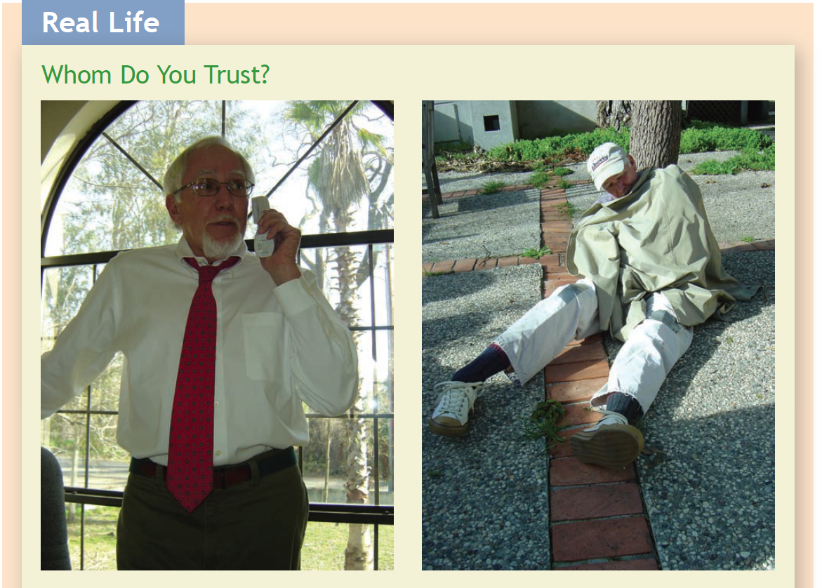
EXAMPLE 2
appearance shouldn’t be a way of establishing credibility but – unfortunately, it is.
If you were asked to make an informed decision on a sensitive topic, I bet you would listen to the gentleman’s advise and safely ignore the beggar’s

Slide 59
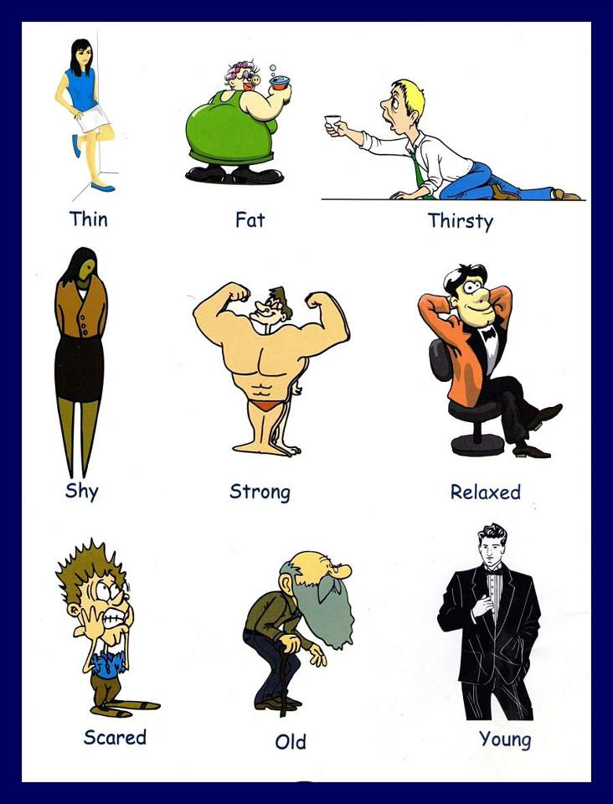
So, this is to demonstrate that we trust too much appearances when it comes to believing what someone tells us.

Slide 60
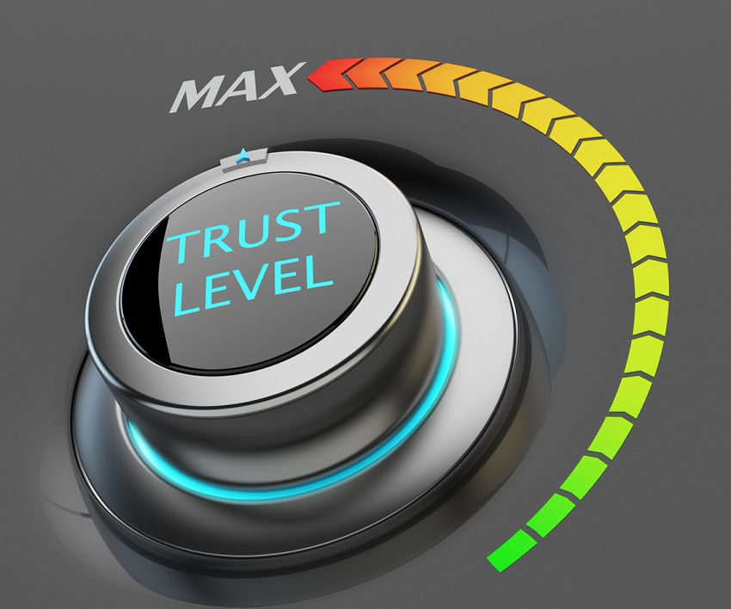
So, we see that there are always two questions to be asked about a claim with which we’re presented.
First, when does a claim itself lack credibility—that is, when does its content present a credibility problem?
Second, when does the source of a claim lack credibility?

Slide 61

1. A claim lacks inherent credibility to the extent that it conflicts with what we have observed or what we think we know—our background
information—or with other credible claims.

Slide 62

EXAMPLE
Imagine that my friend Paolo has just
come from the home of a mutual friend, Francesca, and has seen her new red Audi A5. Suppose now Paolo meets Giovanni, who tells him, “I heard that Francesca has bought a new Audi A5, a bright blue one.”
Paolo does not need critical thinking training to reject Giovanni’s claim about the color of the car, because of the obvious conflict with his earlier observation, of which he is certain.

Slide 63
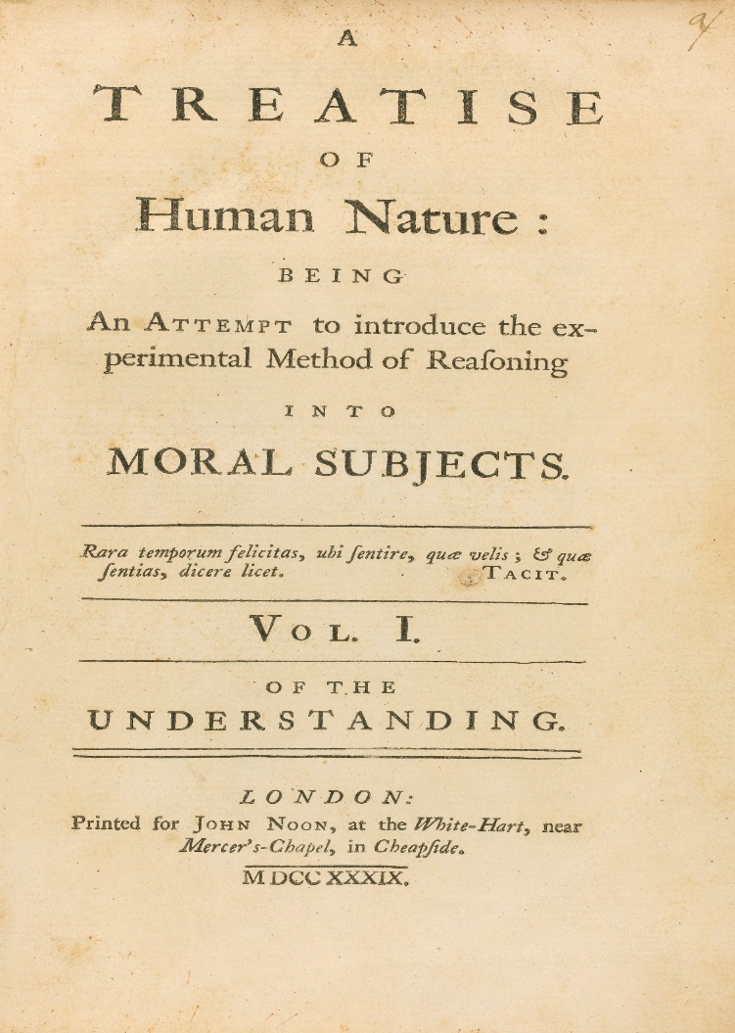
However, observations are not infallible. All kinds of factors influence our observations and our recollections of them
Tiredness, distraction, beliefs, hopes, fears, expectations, worry about an unrelated matter, or emotional upset can all affect our observations!
We must be careful with them

Slide 64

2. Reports must always be evaluated against our background information —that immense body of justified beliefs that consists of facts we learn from our own
direct observations and facts we learn from others

Slide 65

Reports that conflict
with this store of information are usually quite properly dismissed, even if
we cannot disprove them through direct observation.
We immediately reject the
claim “Palm trees grow in abundance near the North Pole,” even though we are
not in a position to confirm or disprove the statement by direct observation

Slide 66
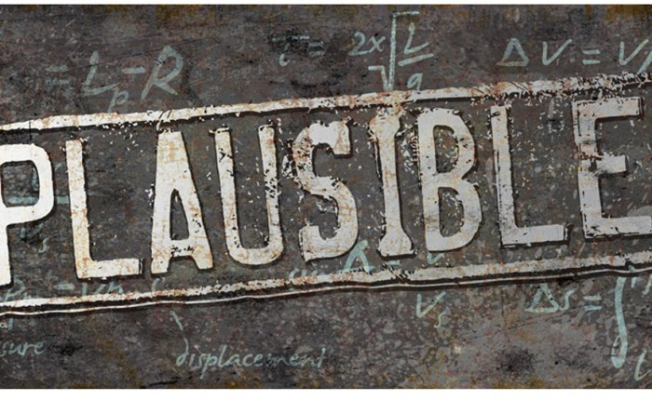
Indeed, this is an example of how we usually treat claims when we first encounter them: We begin by assigning them a certain initial plausibility, a rough assessment of how credible a claim seems to us

Slide 67
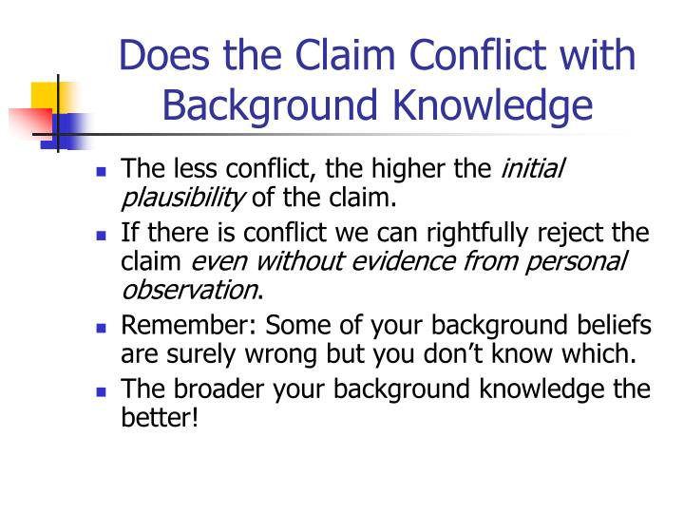
This assessment depends on how consistent the claim is with our background information—how well it “fits” with that information.
If it fits very well, we give the claim some reasonable degree of initial plausibility—there is a reasonable expectation of its being true.
If, however, the claim conflicts with our background information, we give it low initial plausibility and lean toward rejecting it unless very strong evidence can be produced on its behalf

Slide 68
REMEMBER: Background information is essential to adequately assess a claim.
It is pretty difficult to evaluate a report if you have no background information relating to the topic.
This means the broader your background information, the more likely you are to be able to evaluate any given report effectively

Slide 69

Conclusion (take home message): Read widely, converse freely, and develop an inquiring attitude.
There’s no substitute for broad, general knowledge.

Slide 70
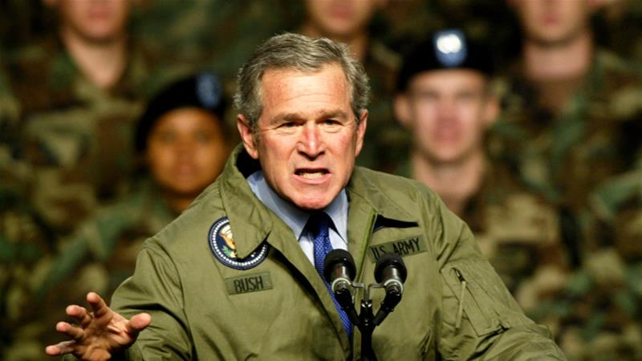
THE CREDIBILITY OF SOURCES
In order to bolster support for the invasion of Iraq in the spring of 2003, President Bush made quite a number of claims about how dangerous the regime of Saddam Hussein had become.
The Bush administration had a number of sources for their information about the situation in Iraq, but one of the most important was Ahmed Chalabi

Slide 71
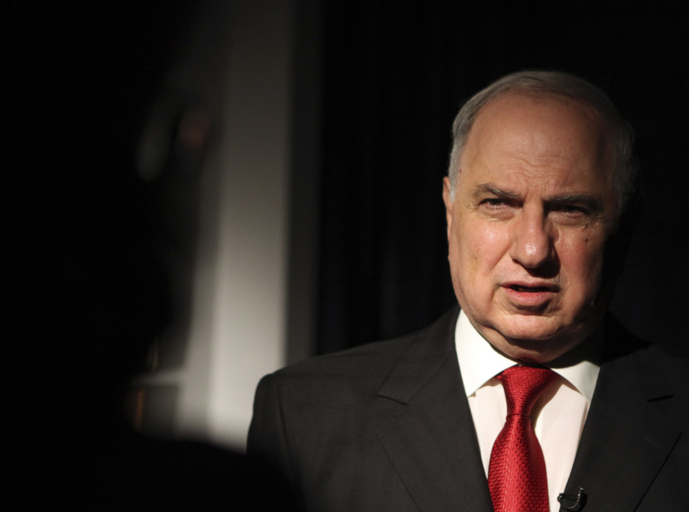
Mr. Chalabi came from a wealthy banking family that made millions before Saddam Hussein’s Baath Party took over in 1968.
Known in the West for his opposition to Saddam Hussein, Chalabi had tried to organize an uprising in Iraq in the mid-1990s.
Supported by members of Congress, the Pentagon, the CIA, and two successive presidents (Clinton and Bush), Chalabi had reason to believe that the United States might support him in becoming Iraq’s next Ruler.
He was an interested party

Slide 72
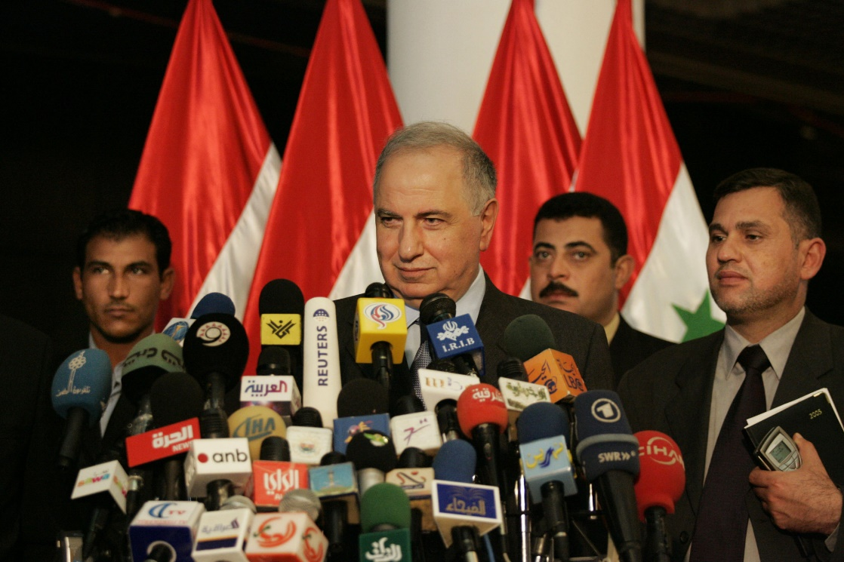
Interested parties are not trustworthy and that their opinions should always
be viewed with skepticism if they cannot be corroborated by disinterested parties or other independent evidence.
As it turns out, a lot of Mr. Chalabi’s claims about Saddam’s Iraq were either exaggerated or proved false by independent
sources

Slide 73
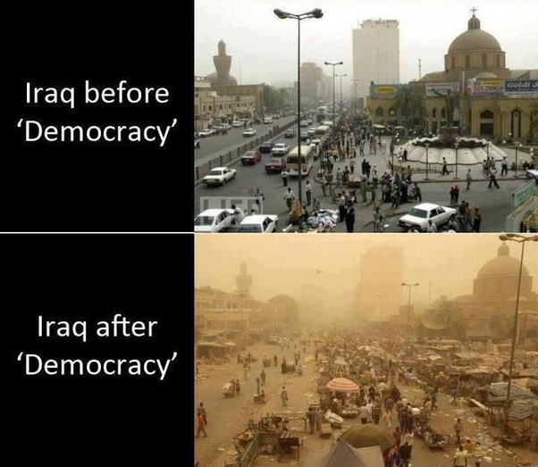
Bush administration gave much more credibility to this source
than it deserved.
While it’s true that an interested party can provide true, accurate, useful information, it is almost always a mistake to simply assume that what one learns from such a source is true and accurate

Slide 74

The doubts we can have about the credibility of a source can be of two kinds: (1) We can doubt whether the source has real knowledge about the issue in question; and (2) we can doubt the person’s truthfulness, objectivity, or accuracy

Slide 75
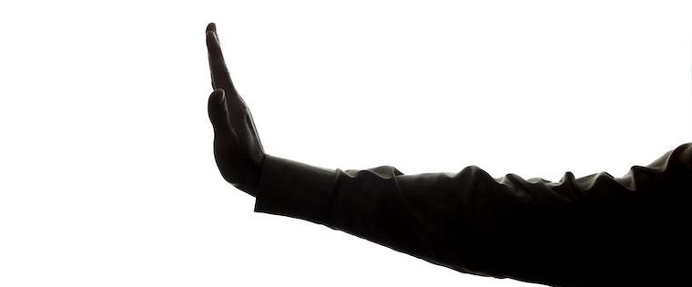
We can say that much of our information nevertheless comes from people about whom we have no reason to suspect prejudice, bias, or any of the other features that make interested parties such bad sources.
Much of our knowledge is not the kind of knowledge involved in geopolitical games (such as in the case of the war in Iraq we just reviewed)

Slide 76

In these cases how do you judge a person’s expertise?
Education and experience are often the most important factors, followed by accomplishments, reputation, and position, in no particular order.
It is not always easy to evaluate
the credentials of an expert, and credentials vary considerably from one field to another.

Slide 77
Education includes, but is not strictly limited to, formal education—the
possession of degrees from established institutions of learning.
Experience—both the kind and the amount—is an important factor in
expertise. Experience is important if it is relevant to the issue at hand, but the
mere fact that someone has been on the job for a long time does not automatically make him or her good at it.
Accomplishments are an important indicator of someone’s expertise but,
once again, only when those accomplishments are directly related to the question at hand.

Slide 78
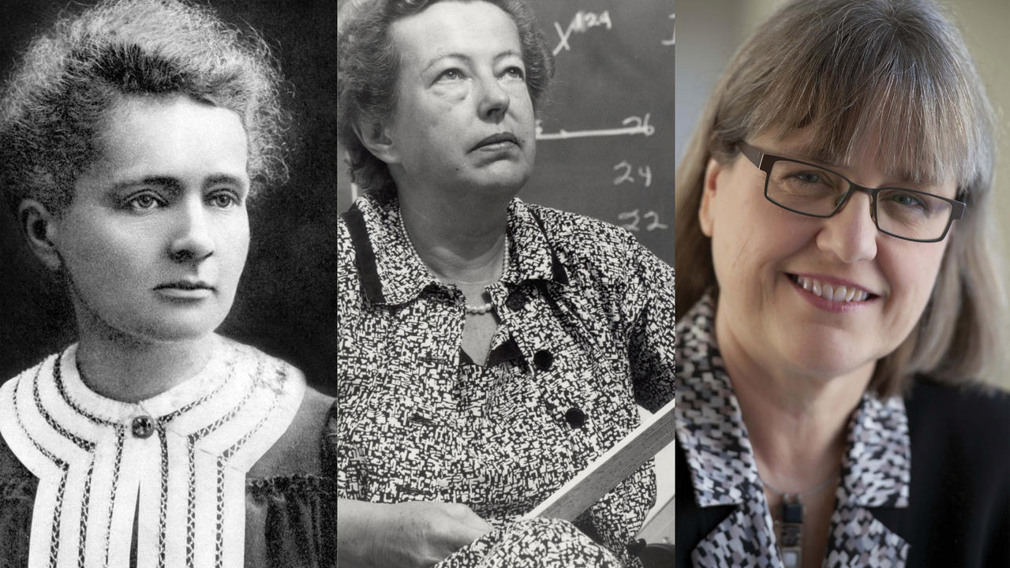
A Nobel Prize winner in physics is not necessarily qualified to
speak publicly about toy safety, or nuclear proliferation.
The last issue may involve physics, it’s true, but the political issues are the crucial ones, and they are not taught in physics labs.

Slide 79

A person’s reputation is obviously very important as a criterion of his or her expertise.
But reputations must be seen in a context; how much importance we should attach to somebody’s reputation depends on the people among whom the person has that reputation.
You may have a strong reputation as a pool player among your friends in the local pub, but that doesn’t necessarily put you in the same league with Efren Reyes (one of the best pool player in history).

Slide 80

The positions people hold provide an indication of how well somebody thinks of them.
The director of an important scientific laboratory, the head of an academic department at Oxford, the author of a work consulted by other experts—in each case the position itself may be substantial evidence that the individual’s opinion on a relevant subject warrants serious attention

Slide 81


But expertise can be bought or be interested parties!
The opinion of a lawyer
retained by the National Rifle Association, offered at a hearing on firearms and urban violence, should be scrutinized much more carefully than that of a witness from an independent firm or agency that has no stake in the outcome of the hearings

Slide 82

In addition, experts sometimes disagree, especially when the issue is complicated and many different interests are at stake.
In these cases, a critical thinker is obliged
to suspend judgment about which expert to endorse, unless one expert clearly represents a majority viewpoint among experts in the field or unless one expert can be established as more authoritative or less biased than the others

Slide 83

Of course, majority opinions sometimes turn out to be incorrect, and even the most authoritative experts make mistakes.
For example, various economics experts predicted good times ahead just before the Great Depression.

Slide 84

When he took the entrance examination for a polytechnic school in Zurich, he flunked
[Failed several sections of his exam]
So his professor thought he would never graduate

Slide 85

Finally, we sometimes make the mistake of thinking that whatever qualifies someone as an expert in one field automatically qualifies that person in other areas.
Being a Nobel prize in physics is not an indication of being a top computer scientist!!

Slide 86

CREDIBILITY AND THE NEWS MEDIA
FACT: In the USA (but this applies to much of Western world as well) media ownership dropped to only fifty companies by 1983. By late 2004, the majority of all media companies in the United States were controlled by just five companies.

Slide 87

TREND: Centralization of Information- which should worry you!

Slide 88

Government Management of the News
For a while there, our only known source of fake news was Jon Stewart on The Daily Show. But the federal government got into the fake news business as well.
A number of fake news reports, paid for by the government, have appeared on television praising the virtues of government schemes from
the prescription drug program to No Child Left Behind (which was aimed at improving American students’ international competitiveness in reading and math)
No criticism of the programs was included, and no mention was made that these were not legitimate independent news reports but rather were produced by the very same governmental departments that produced the policies in question

Slide 89
Military example, a particularly good one
The military has its own methods for managing the media, from not allowing photographs to be taken of the coffins of slain American soldiers when they are sent home from Iraq to the more elaborately produced example which follows in the next slide”

Slide 90


Slide 91

The Internet
This sort of control is exercised by the governments over all media, TV and Radio. But today we focus on the Internet.
That amalgamation of
electronic lines and connections that allows nearly anyone with a computer
and a modem to link up with nearly any other similarly equipped person on
the planet.
Although the Internet offers great benefits, the information it provides must be evaluated with even more caution than information from the print media, radio, or television.

Slide 92
There are basically two kinds of information sources on the Internet.
The first consists of commercial and institutional sources;
the second, of individual and group sites on the World Wide Web.

Slide 93

Just as the fact that a claim appears in print or on television doesn’t make it true, so it is for claims you run across online.
Keep in mind that the information you get from a source is only as good as that source

Slide 94

Possibly the fastest-growing source of information in terms of both its size and its influence is the online encyclopedia Wikipedia.
“Wiki” refers to a collaborative voluntary association. Begun in 2001 by Larry Sanger and Jimmy
Wales, the encyclopedia’s content and structure are determined by its users.

Slide 95

This accounts for its major strengths as well as its major weaknesses.
Because there are thousands of contributors, the coverage is immense.
Because access is available to virtually everybody who has a computer and modem, coverage is often very fast;
articles often appear within hours of breaking events

Slide 96
But also because of this wide access, the quality of the articles varies
tremendously.
You should be especially wary of recent articles; they are more
likely to contain uncorrected errors that will eventually disappear as knowledgeable people visit the page and put right whatever mistakes are present. Not just factual errors but bias and omission can affect the quality of material found on Wikipedia’s pages. Occasionally, a writer will do a thorough job of reporting the side of an issue that he favors, and the other side will go underreported or even unmentioned.
Over time, these types of errors tend to get corrected after visits by individuals who favor the other side of the issue. But at any given moment, in any given Wikipedia entry, there is the possibility of mistakes, omissions, citation errors, and plain old vandalism.

Slide 97

My advice: Wikipedia is an excellent starting point in a search for knowledge about a topic. I use it frequently.
But you should always check the sources provided in what you find there; it should never be your sole source of information if the topic is important to you or is to become part of an assignment to be turned in for a class

Slide 98

Blogs are simply journals, the vast majority of them put up by individuals, that are left open to the public on an Internet site. Originally more like public diaries dealing with personal matters, they now encompass specialties of almost every imaginable sort

Slide 99
Blogs perform useful services—it was a blogger
who exposed James Guckert, the fake reporter who somehow obtained White House press credentials and asked “softball” questions at White House
press conferences.
On the other hand, you can find blogs that specialize in satire, parody, and outright fabrication. They represent all sides of the political spectrum including some sides that we wouldn’t have thought existed at all.
REMEMBER: BLOGS ARE LUCRATIVE SO OFTEN – IF NOT ALWAYS- THEY ARE RUN FOR EARNING MONEY

Slide 100

You can take advantage of these sources, but you should always exercise caution, and if you’re looking for information, always consult another source, but not one that is linked to your first source!

Slide 101

Remember, when you take keyboard and mouse in hand, be on guard. You have about as much reason to believe the claims you find on most sites as you would if they came from any other stranger, except you can’t look this one in the eye
So, Protect yourself, always!

Slide 102


